Slide 1
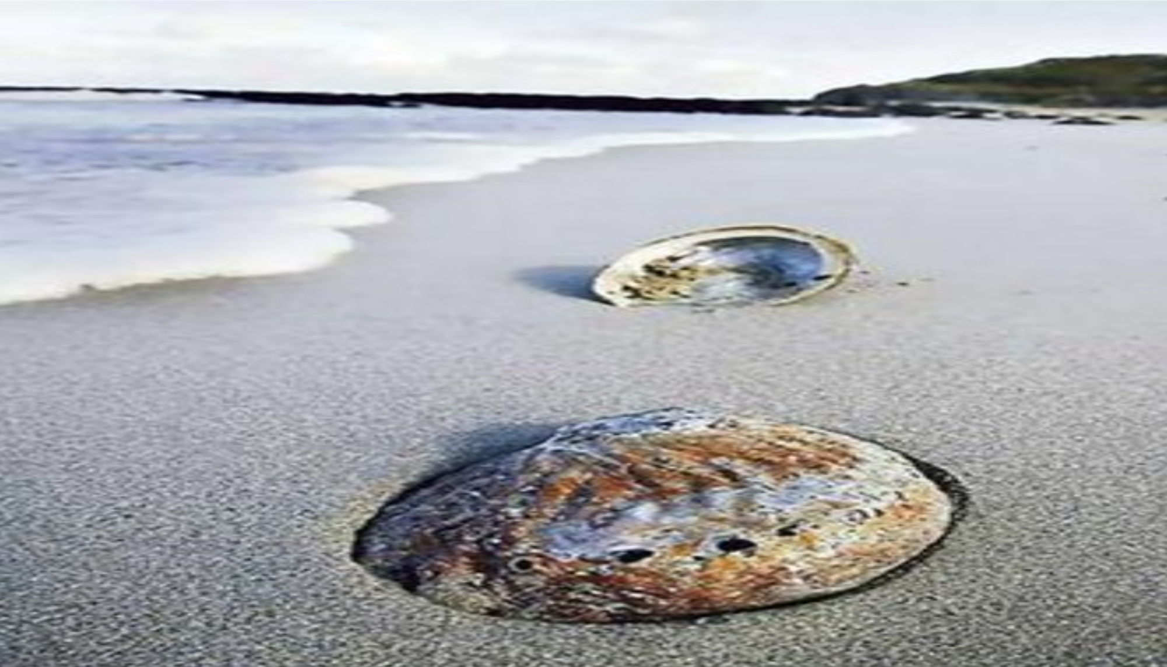
ABALONE AGE PREDICTION USING IBM WATSON
IT TEAM 01:
B.SAI SANJANA
A V N S SOWMYA
A.MANASA
B.NISHITHA
A.SATWIK

Slide 2
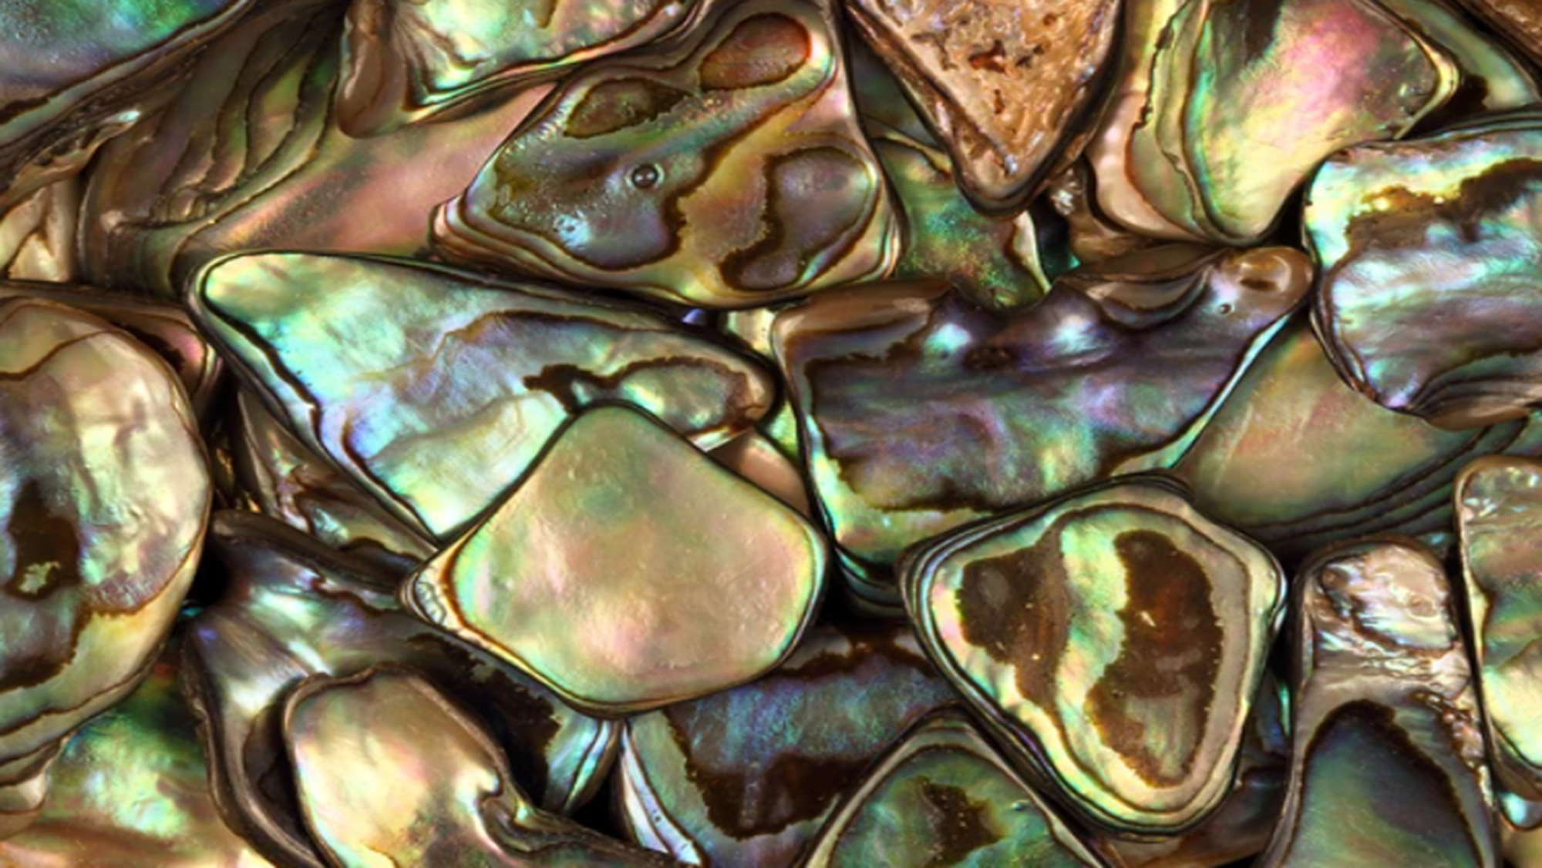
INTRODUCTION:
Abalone is a shellfish considered a delicacy in many parts of the world.
An excellent source of iron and pantothenic acid, and a nutritious food resource and farming in Australia, America and East Asia. 100 grams of abalone yields more than 20% recommended daily intake of these nutrients.
The economic value of abalone is positively correlated with its age. Therefore, to detect the age of abalone is important for both farmers and customers to determine its price.

Slide 3
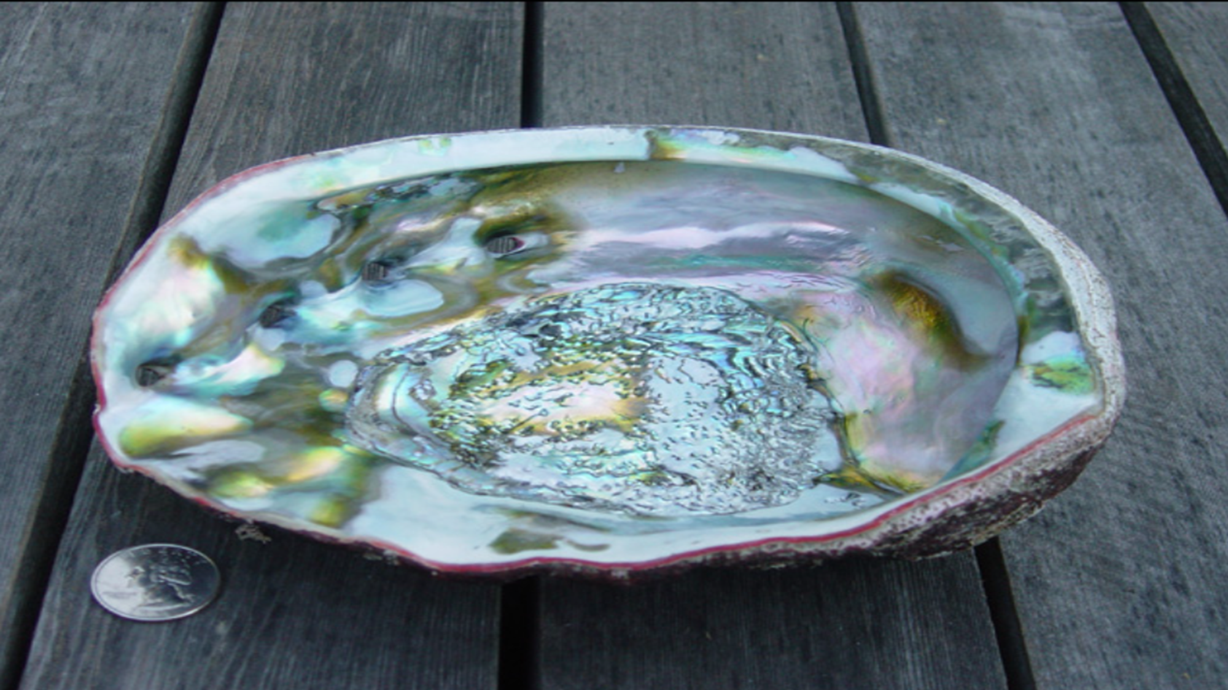
THE DATASET:
9 physical characteristics:-
Sex
Length
Diameter
Height
Whole weight
Shucked weight
Viscera weight
Shell weight
Rings

Slide 4
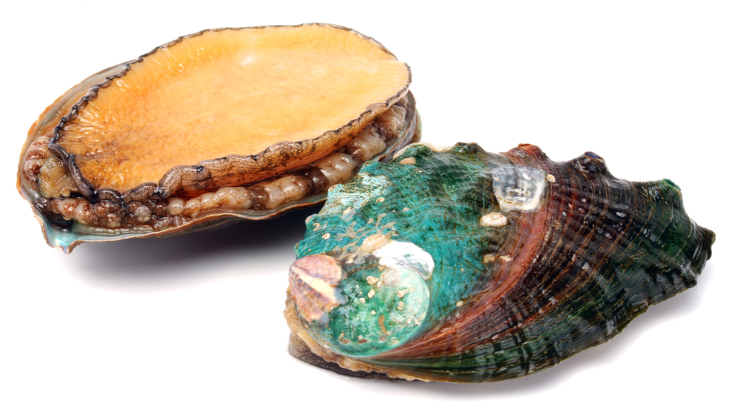
ENVIRONMENT AND TOOLS USED:
Scikit-learn.
Numpy.
Keras.
Pandas.
Matplotlib.
Model building through Jupyter notebook.
Using HTML,CSS and JAVAScript for webpage.
Using flask for integrating model and webpage in SPYDER environment.

Slide 5
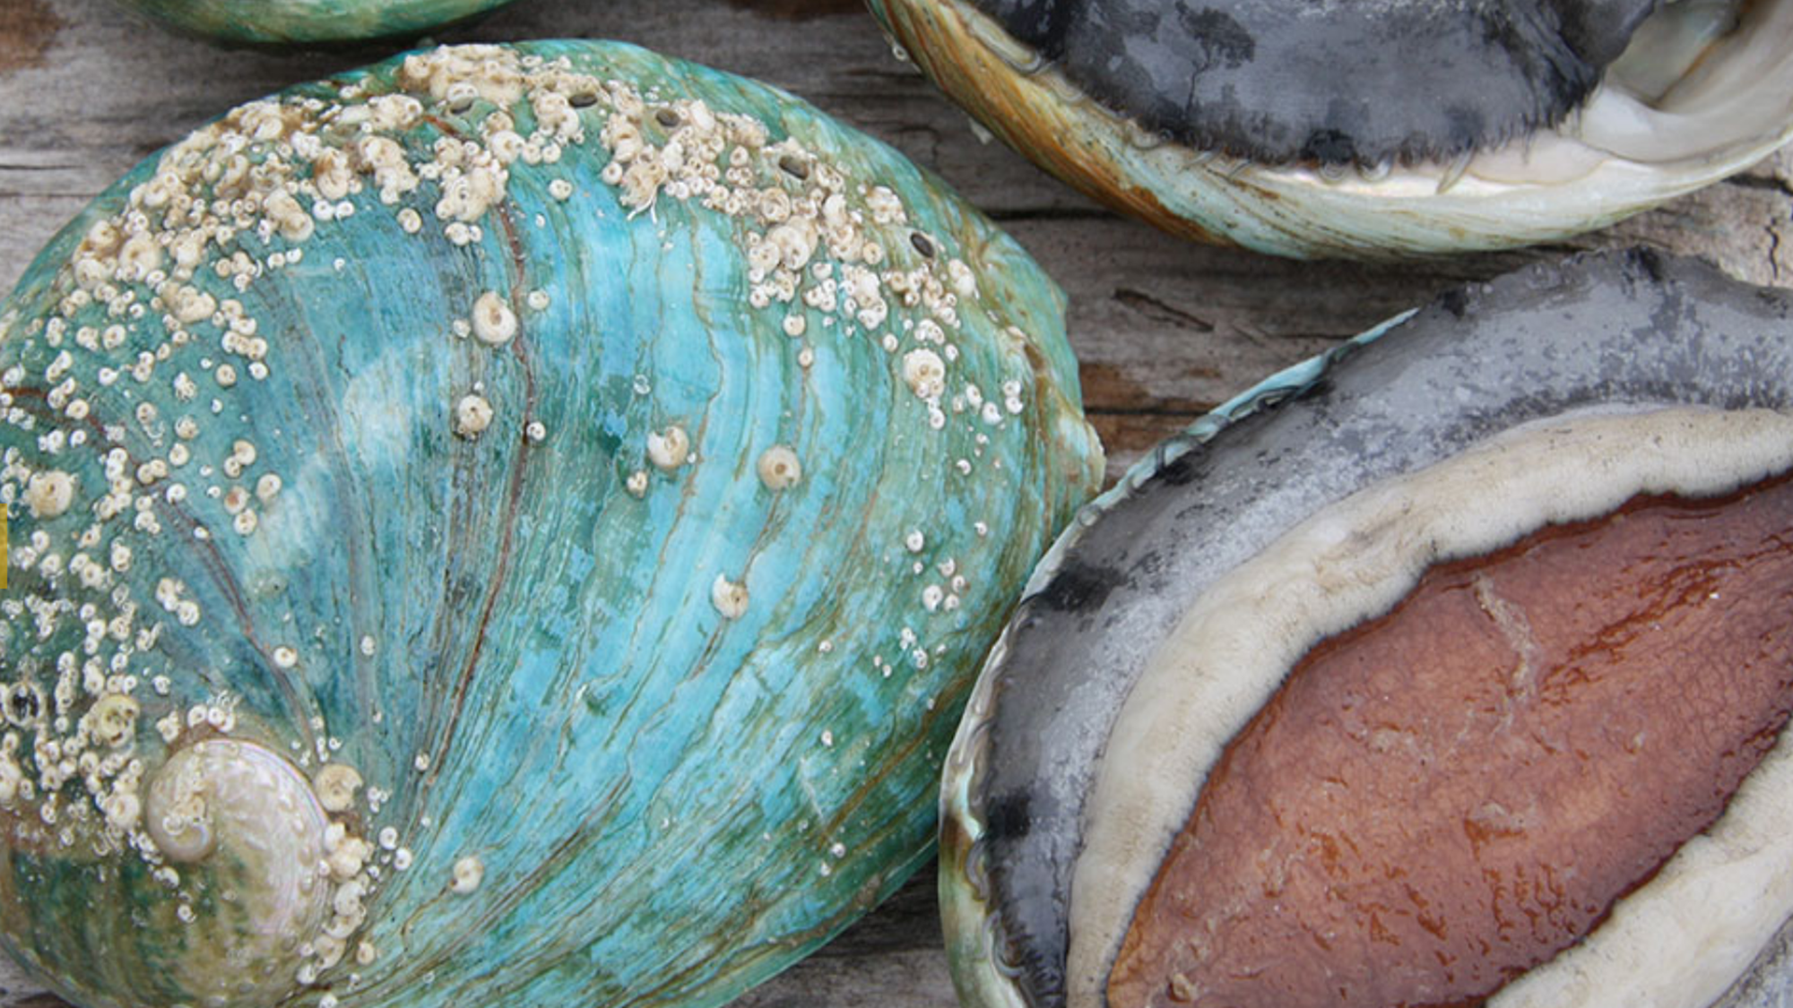
PROJECT RESULT:
We are able to understand the problem to classify is a regression kind of problem.
We are able to know how to pre-process / clean the data using different data pre-processing techniques.
We are able to analyze or get insights of data through visualization.
Applying different algorithms according to dataset and based on visualization.
We are able to know how to find the accuracy of the model.
We are able to know how to predict Age of Abalone.

